Slide 1

DATA ANALYTICS IN SMART GRIDS
Internet of Things Lab, Carleton University, Canada

Slide 2
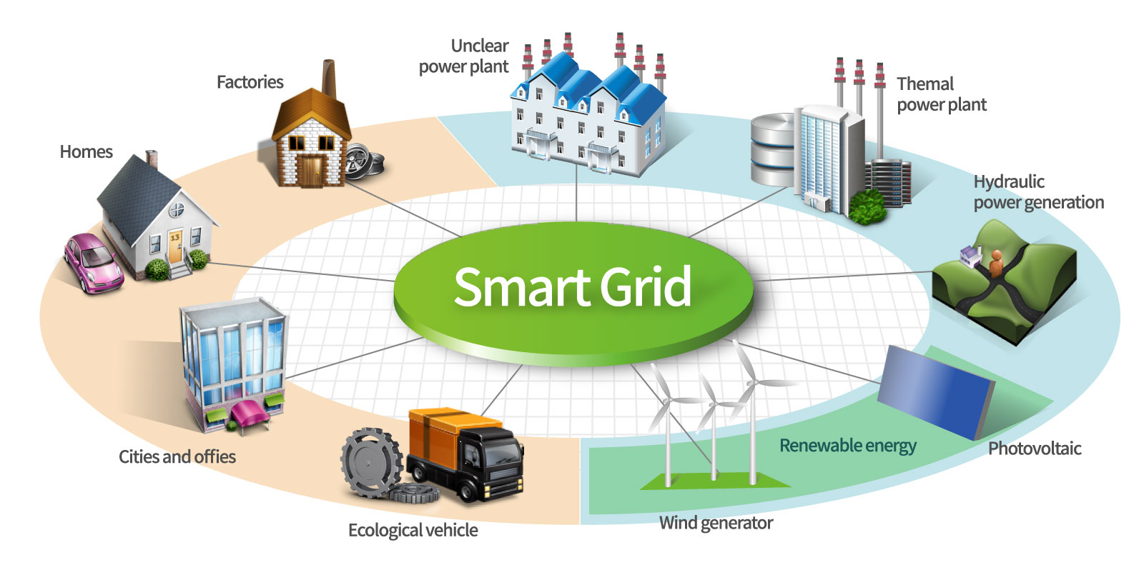
Smart Grids
Image source: https://www.csiac.org/journal-article/the-efficacy-and-challenges-of-scada-and-smart-grid-integration/2/
Notes:
Conventionally, no feedback…
Bi directional communication of data of all generator, consumers
Respond to local changes in the usage to optimize the load at grid

Slide 3
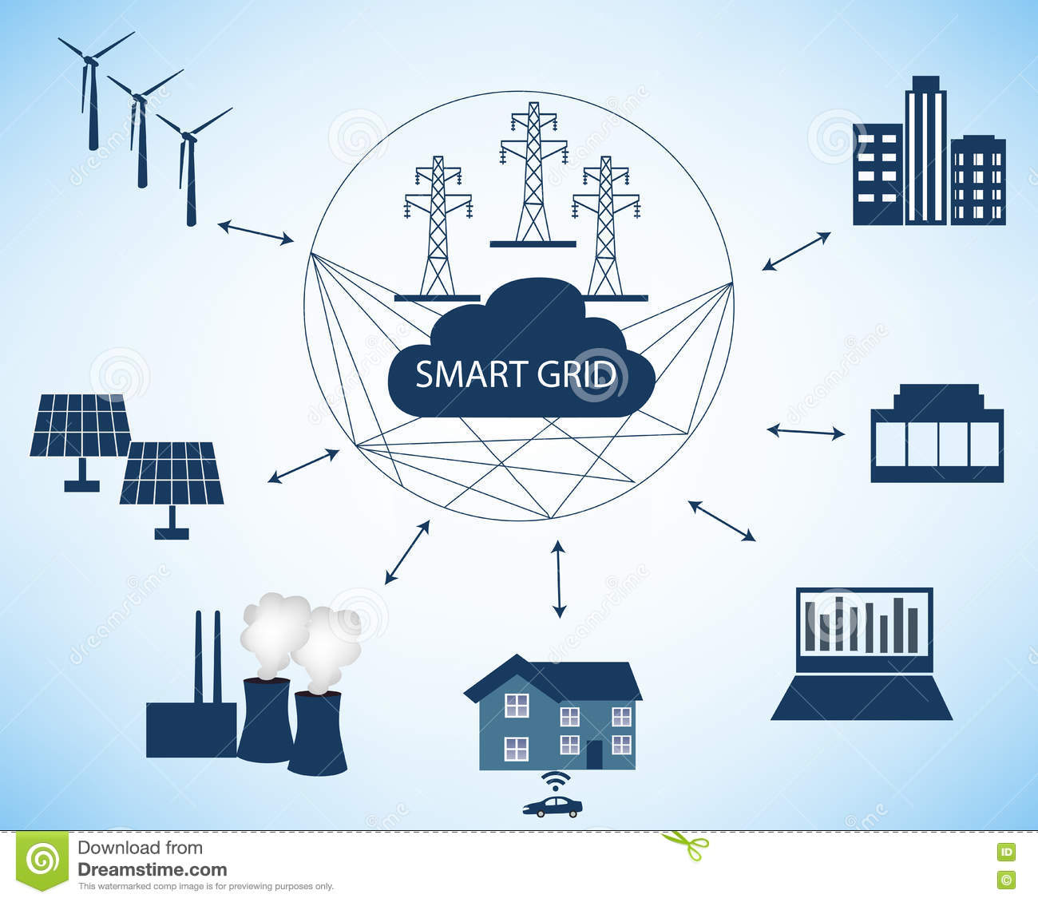
Smart Grids and Cloud Computing
Notes:
Conventionally, no feedback…
Bi directional communication of data of all generator, consumers
Respond to local changes in the usage to optimize the load at grid

Slide 4
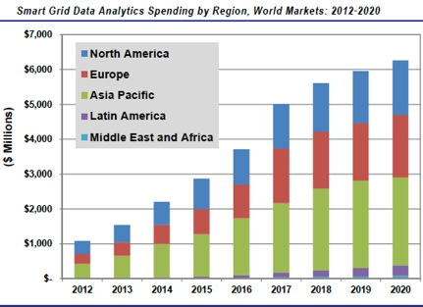
Big Data Analytics in Smart Grids
Costumer Segmentation
Demand Response
Workforce optimization
Theft and leak detection
Identify likely source of outages
Marketing based on consumer behavior
Source: Pike Research Survey 2016
Notes:
Storage access and analyze the data over the internet
Computational resources of local devices are limited
e.g.200,000 homes data of 2 years analyze, store
But cloud computing provides all these facilities+ predictive analyses
Big 4 companies
Pricing models
Computational resources allowance
Space, analysis different
Synergy provides quarterly market tracking and segmentation data on IT and Cloud related markets, including vendor revenues by segment and by region.

Slide 5
Block Diagram

Slide 6
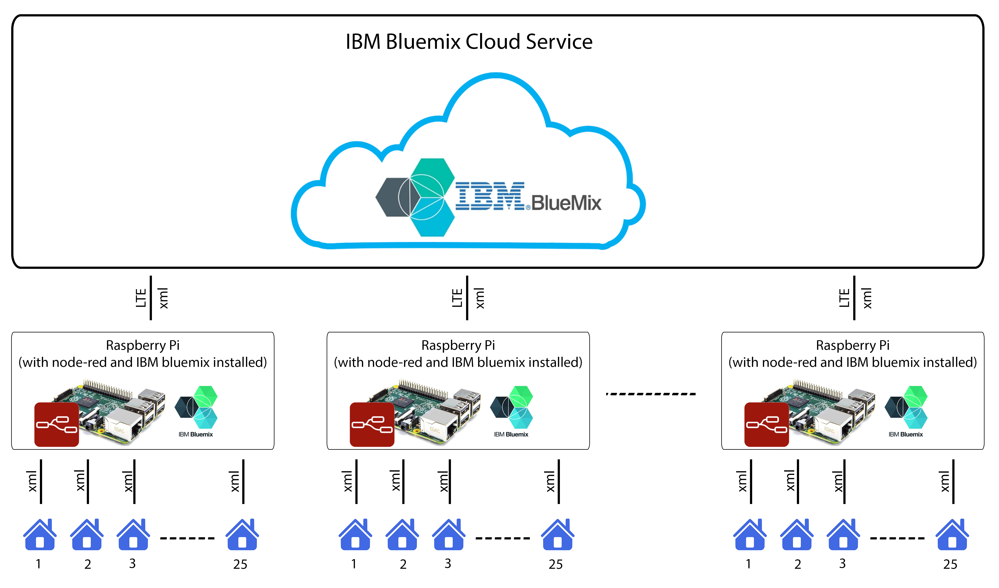
Notes:
This block diagram explains it all. Here is my R Pi and it gets 25 different xml files in real time, from 25 homes in a neighbor hood. Each xml has unique home ID, current load in Amp and a negotiation parameter which can be Yes or No. it depends on each home whether they want to negotiate with the utility company on their load or not.
If they negotiate, they will be getting recommendations from the utility regarding their load e.g if the load is greater than 200Amp, utility can recommend them to reduce their load to save energy. It is a win-win situation for both, the utility company and the home.
Lines show bi-directional communication , that’s y I didn’t put an arrow
Some challenges:
LTE module (sierra aircard 330U)
xml files instead of raw sensor data
asynchronous nature of node-red flows

Slide 7
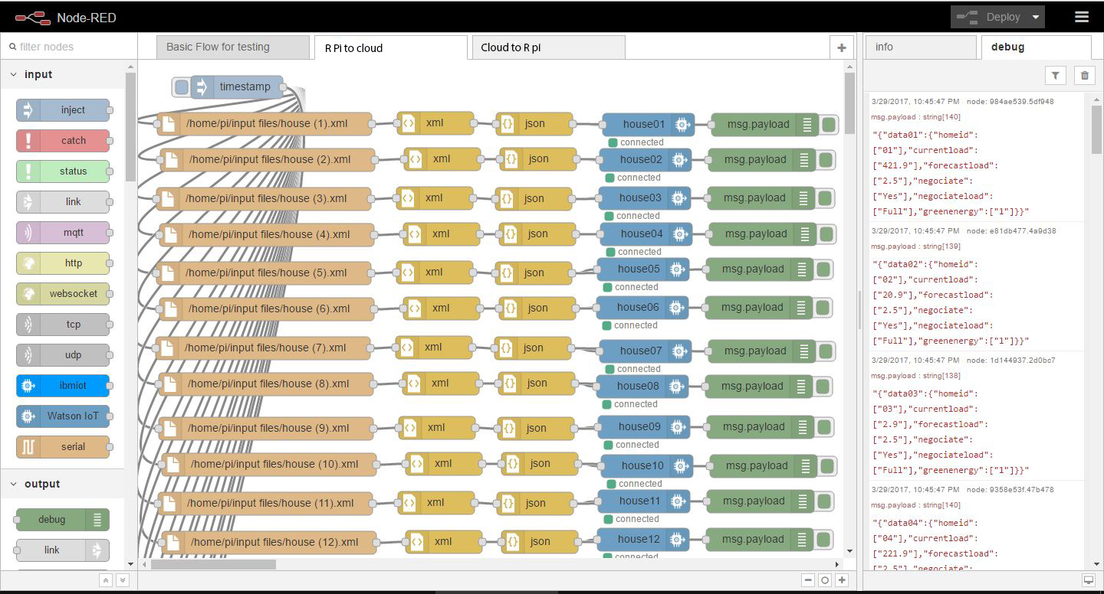
Inside Raspberry Pi block (data to cloud)
Notes:
Node red is a library or you can say it’s a programming tool for wiring together hardware devices, APIs and online services in a very interesting way.
The good thing is that It provides a browser-based editor were nodes can be wired together.
Here is what happens inside R Pi. I installed IBM bluemix and set up my Rpi with unique authentication key to maintain privacy and security of home data.
Node-red is already installed on Pi and IBM bluemix also supports Node-Red. Moreover, its very powerful and provides different features like graphs etc can be drawn as well. So I decided to go with this environment.
It has 2 parts:
1)Pi to Cloud (show the values)
Timestamp for real time collection of data,
Collect xml files and send them to cloud for processing.
Bluemix only accepts JSON format.

Slide 8
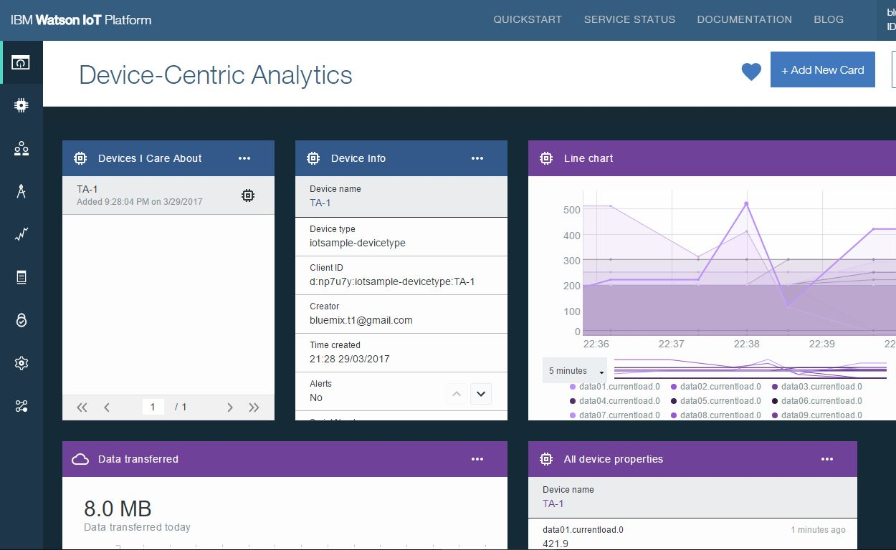
Inside IBM Bluemix block
Real time line chart display of electric load of all the houses in each neighborhood
Check for the highest and lowest load in each neighborhood
Store each house’s data history in Cloudant database of IBM Bluemix
Separate line chart display of history of each house
Approximate the near future consumption of each house using linier regression model on its previous track record
Predictive analysis on the electricity consumption of each neighborhood
Check for houses who have not opted for negotiation, and are exceeding the critical limit of load
Give recommendations to those who have opted for negotiation, and send modified xml file back to the house
Publish tweets automatically in case any outage is expected due to a sudden increase of load for a particular neighborhood
Notes:
Each input node has a key to take the data from only a particular house with which the key matches. So this is a good security feature.
Explain the above 4 points.
Highest and lowest load for a particular cycle, cycle repeats every 10 sec
Graph can also go back to any particular time to check the current
Similarly we can draw other graphs as well
dashboard display electric parameters of each house
This model is very scalable-add more houses, functions etc.

Slide 9
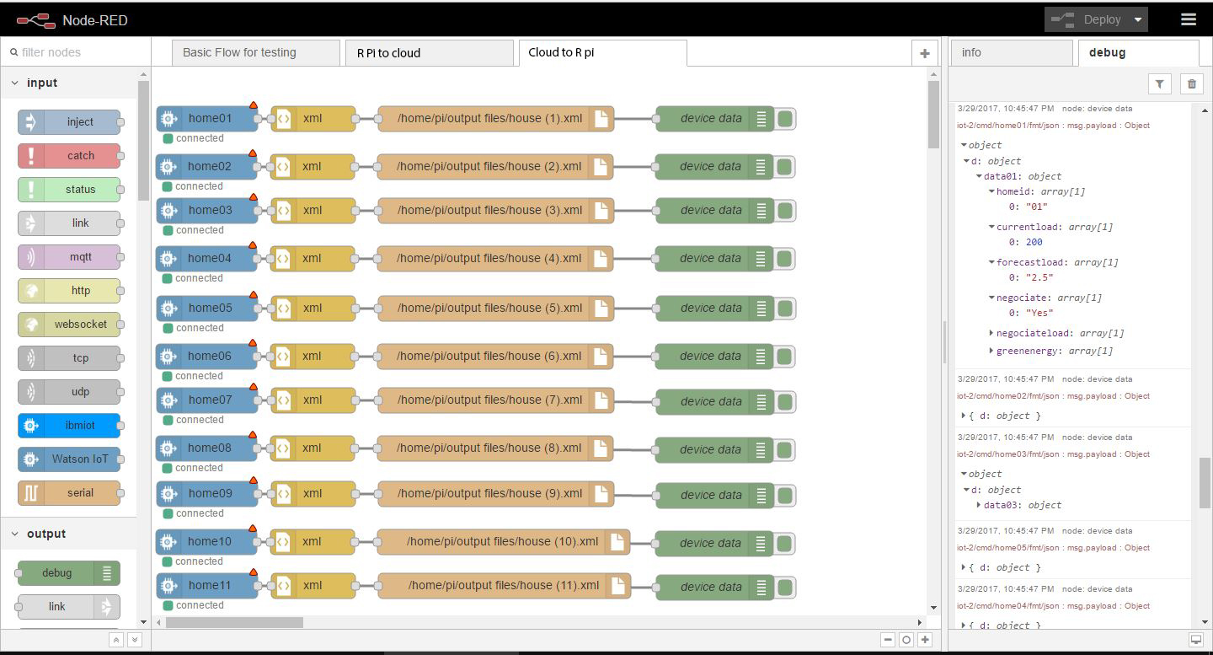
Inside Raspberry Pi block (data from cloud)
Notes:
2) Cloud to Pi
Receive modified xml files from cloud and send them back to individual homes
All this happens in less than a second (see the timings)

Slide 10
Future Work
Include other electric parameters
Add more Raspberry Pis which means more neighborhoods
Add more complex data analytics using training and pre-processing (dimensionality reduction) of the data

Slide 11
Demo

Slide 12
Thank you! Questions?
Arslan Ahmed
arslan.m.ahmed@gmail.com

